Slide 1


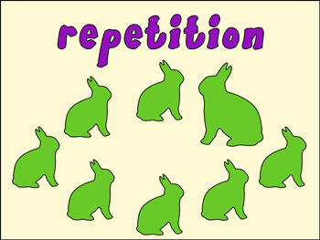

Introduction To Programming
Repetition Structures
SoftUni Team
Technical Trainers
Software University
http://softuni.bg

Slide 2

Table of Contents
What is a repetition structure?
How can they be useful to us?
What types of repetition structures does C# support?
What does every repetition structure need to have?
Different ways to make repetition

Slide 3
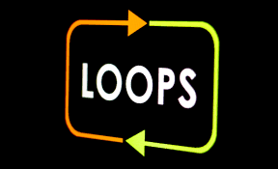
What is a repetition structure
Repetition structures, or loops, are used when a program needs to repeatedly process one or more instructions until some condition is met
can help us execute one or more statements up to a desired number of times
Executing a repetitive action trough a loop helps us avoid code repetition

Slide 4
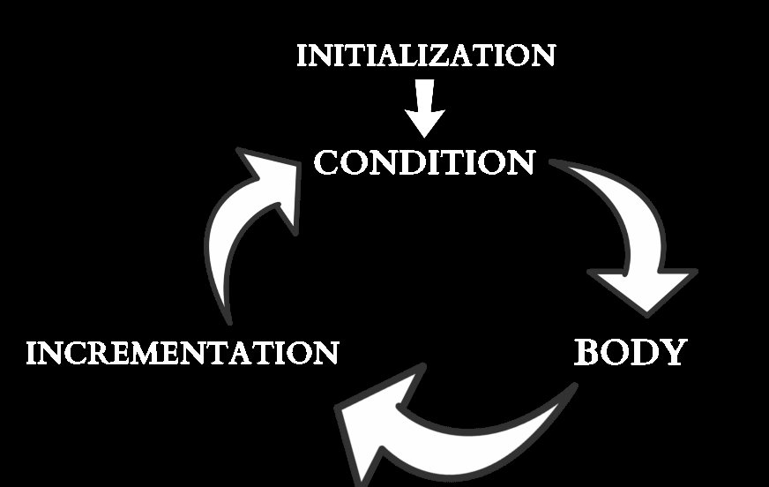
Elements of a loop
Constructing a loop requires four elements:
Initialization
Condition
Body
Incrementation / Actualization
Different loops implement these
elements in a different way.

Slide 5

Loops

Slide 6
While loop
The while loop repeatedly executes a block of statements until a specified Boolean expression evaluates to false
Initialization
int number = 20;
int factorial = 1;
while(number > 1)
{
factorial = number * factorial;
number--;
}
Console.WriteLine(“Factorial of 20 – “ + factorial);
Condition
Body
Incrementation

Slide 7
While loop Example
This is a simple representation of the while loop
False
START
X = 10
X < 20
True
OUTPUT X
X = X + 1
STOP

Slide 8
Do - While loop
The do-while loop is almost the same as the while loop except it evaluates its condition after
will always execute the block of code at least ONCE
Initialization
int number = 1; //this should break the loop
do
{
Console.WriteLine(“I will loop at least once!”);
number--;
}
while(number != 1);
Console.WriteLine(“Number is now – “ + number);
Body
Incrementation
Condition

Slide 9
Do - While loop Example
This is a simple representation of the while loop.
True
START
X = 10
OUTPUT X
X = X + 1
X < 20
False
STOP

Slide 10
For loop
The for loop combines the three elements of iteration into a more readable code
the initialization expression
the termination condition expression
the counting expression
Initialization
Condition
Incrementation
for(int i = 0; i < 10; i++)
{
Console.WriteLine(“Current number is – “ + i);
}
Console.WriteLine(“Loop has finished successfully.“);
Body

Slide 11
Foreach loop
The foreach loop is useful for iterating through the elements of a collection
Initialization,
Condition,
Incrementation
int[] numbers = new int[]{ 1, 2, 3, 4, 5, 6, 7, 8 };
Int[] secondaryNumbers = new int[8];
foreach(var number in numbers)
{
Console.WriteLine(“The current number is – “ + number);
secondaryNumbers[number - 1] = number;
}
Console.WriteLine(“Foreach loop has finished!”);
Body

Slide 12

Recursion

Slide 13
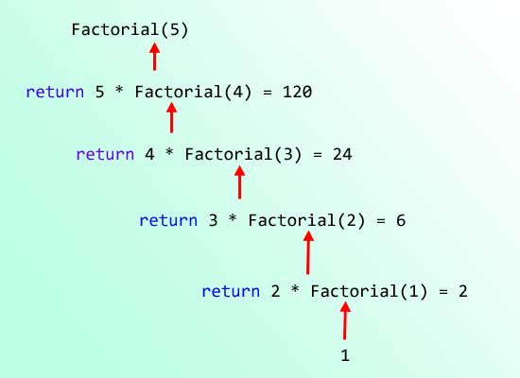
Recursion
Recursion is solving methodology pattern which relies on finding a solution for smaller problem in order to find a solution for bigger one
public static int Factorial(int number)
{
if(number == 1)
{
return 1;
}
return number * Factorial(n – 1);
}

Slide 14
Recursion
To construct a recursive method, we must have:
base case – the terminating condition, and the bottom of the recursion.
recursive case – the step-forward into the algorithm – the recursive call.
Terminating condition
public static int Factorial(int number)
{
if(number == 1)
{
return 1;
}
return number * Factorial(n – 1);
}
Base Case
Recursive Case

Slide 15
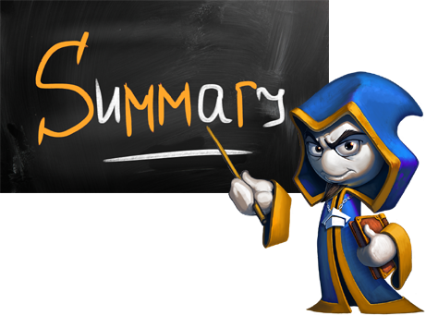
Summary
What are loops?
What do we need to make a loop – the four elements of a loop
Differences in the syntax and behavior of different loops
What is Recursion?
What is necessary to have, when making a recursive algorithm

